Slide 1
Predicting outcomes for Adjudicative appeals through Machine Learning
Michaela Webster
MSISPM Thesis Presentation
May 6, 2019

Slide 2
Previous work
Thesis by Sarah Miller (MSISPM 2017)
Database for Adjudicative Appeals cases
Includes data points for all guidelines
Primary focus on falsification
Notes:
Created a database for cases – includes information on decisions and reasons for initial denial
Hand coded cases from documents in api
Preliminary stats done on information (20,000+ records)
Focus on falsification (about ¼ of cases in data set) – only up to 2016 (still need to code 2017&2018)

Slide 3
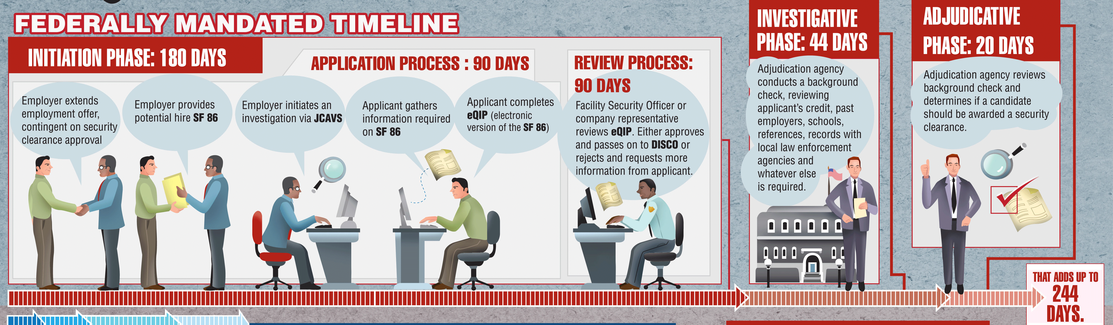
Security Clearance process
https://4d0q7u11k31p1qnkosal8q2e-wpengine.netdna-ssl.com/wp-content/uploads/2013/04/security-clearance-process-infographic.gif
Notes:
Hired -> job asks for investigation -> fill out SF86 -> reviewed -> decision made
There are 13 adjudicative guidelines:
A: Allegiance to the U.S.
B: Foreing Influence
C: Foreing Preference
D: Sexual Behavior
E: Personal Conduct
F: Financial Considerations
G: Alcohol Consumption
H: Drug Involvement
I: Psychological Conditions
J: Criminal Conduct
K: Handling Protected Information
L: Outside Activities
M: Use of Information Technology

Slide 4
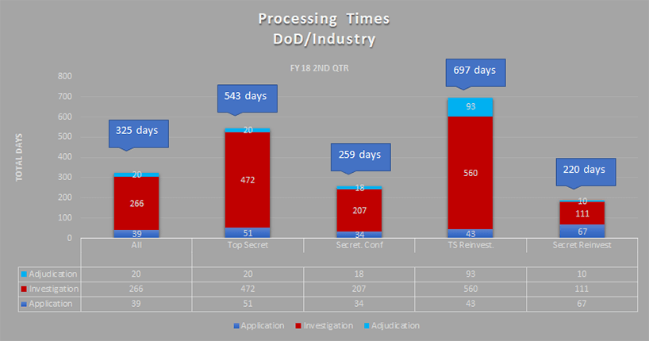
https://news.clearancejobs.com/2018/07/18/security-clearance-processing-times-continue-to-creep-upward/
Notes:
Averages > 1 year
Due to robustness of application information/investigation process
Significant backlog of applications and appeals (500,000) - https://news.clearancejobs.com/2019/04/16/latest-update-on-the-security-clearance-backlog-and-transfer-to-dod/

Slide 5
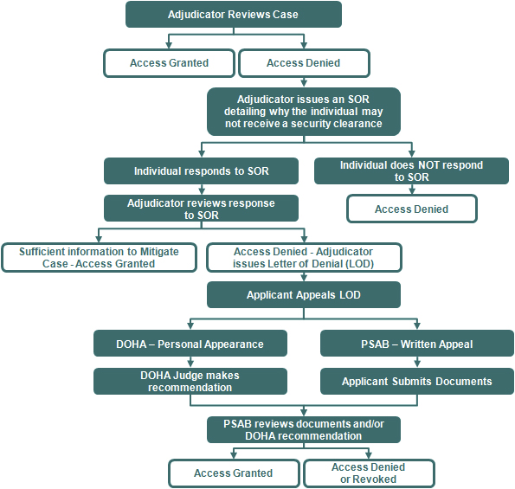
Adjudicative appeals
http://www.dami.army.pentagon.mil/site/PSAB/AdjProc.aspx
Notes:
Process:
Denied -> send notes to individual -> send back responses -> APPEAL -> reinvestigate -> decision

Slide 6
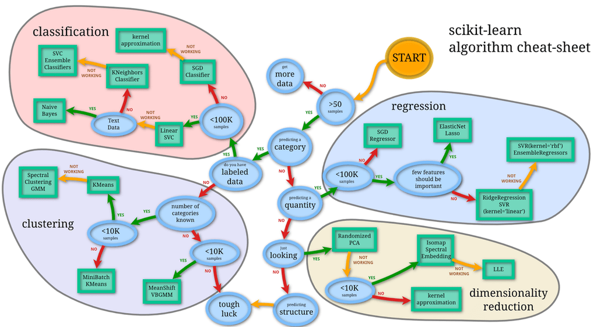
Machine learning
http://blog.kaggle.com/2015/04/15/scikit-learn-video-2-setting-up-python-for-machine-learning/
Notes:
Pros:
Helpful for making complex decisions in little time
Lots of information and apis online with support
Powerful and theory/stats driven
Cons:
Depends on dataset
Depends on input
Could be slow/costly to implement

Slide 7
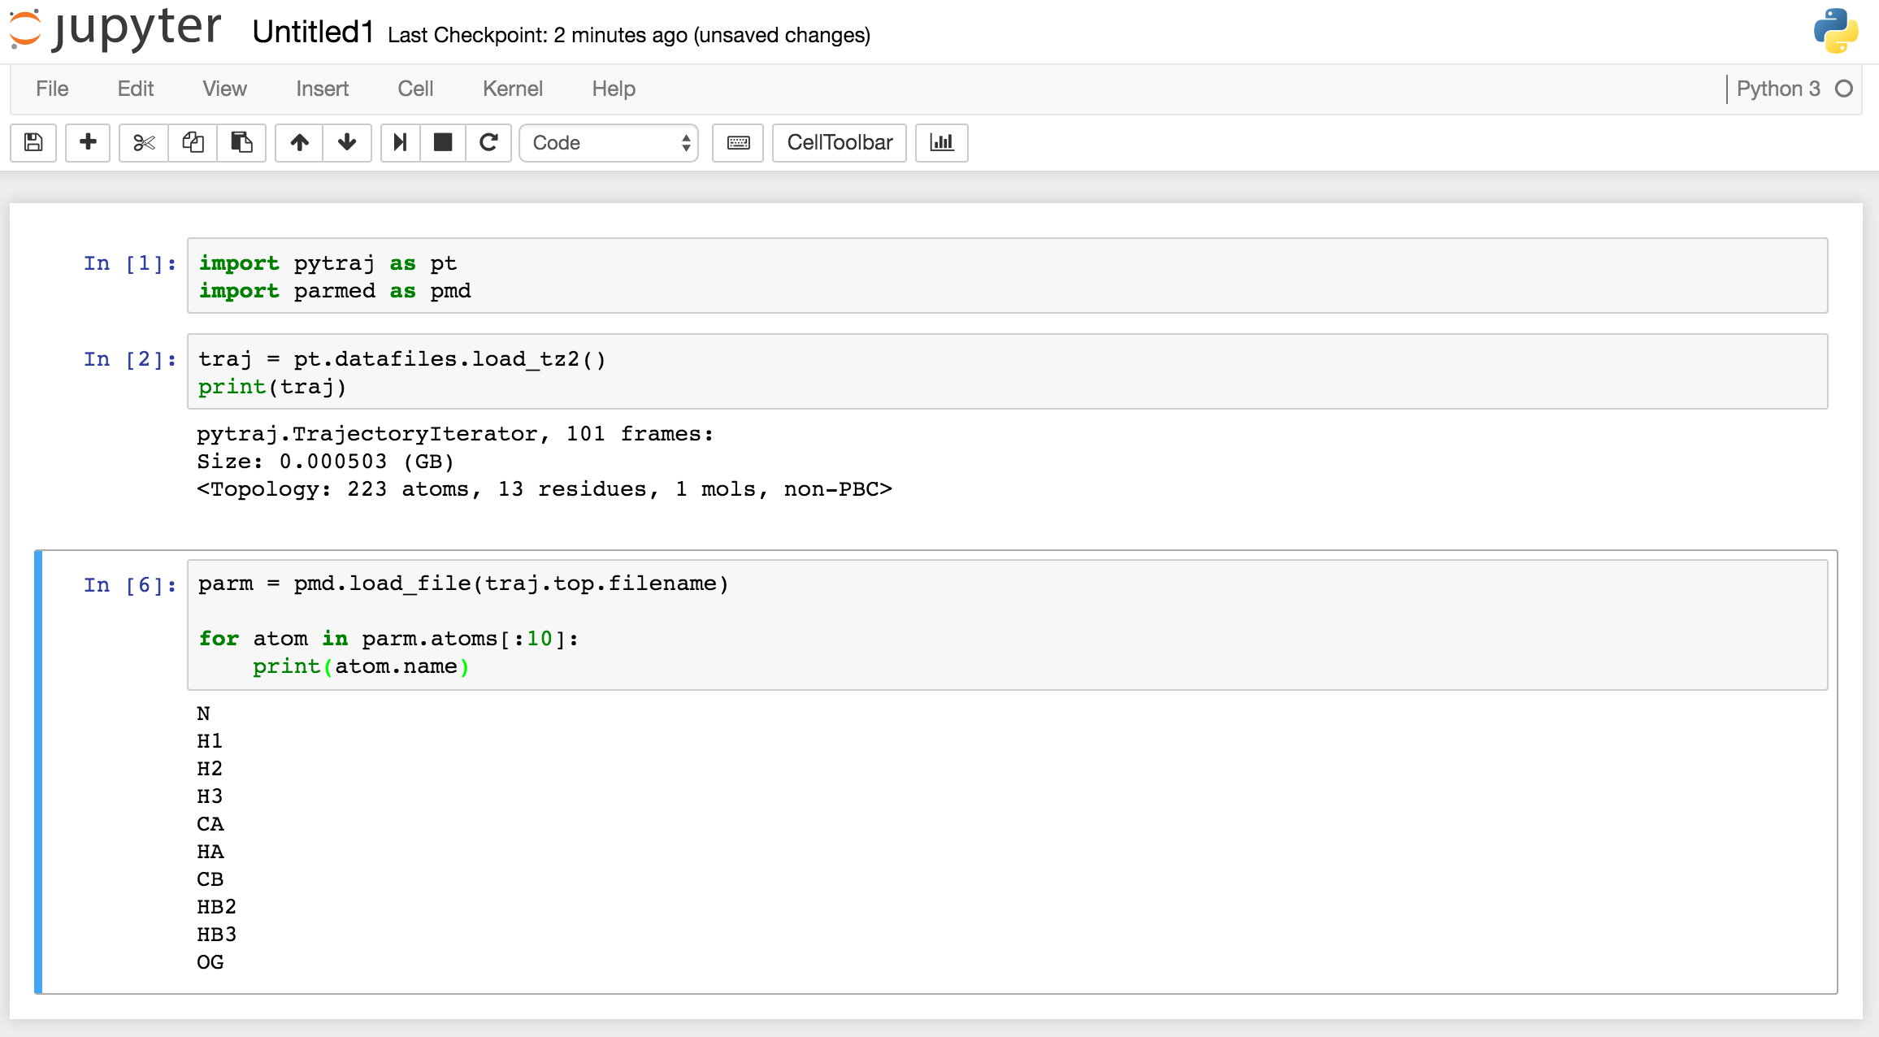
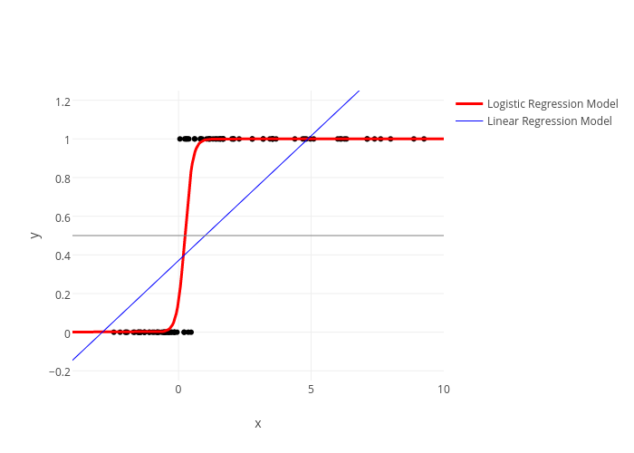
tools
https://plot.ly/scikit-learn/plot-logistic/
http://ambermd.org/tutorials/analysis/tutorial_notebooks/remote_notebook/index.html
Notes:
Jupyter notebooks:
Simple design
User friendly
Easy to debug code
Graphs
Sci-Kit Learn:
Machine learning api
Lots of documentation
Lots of functionality

Slide 8
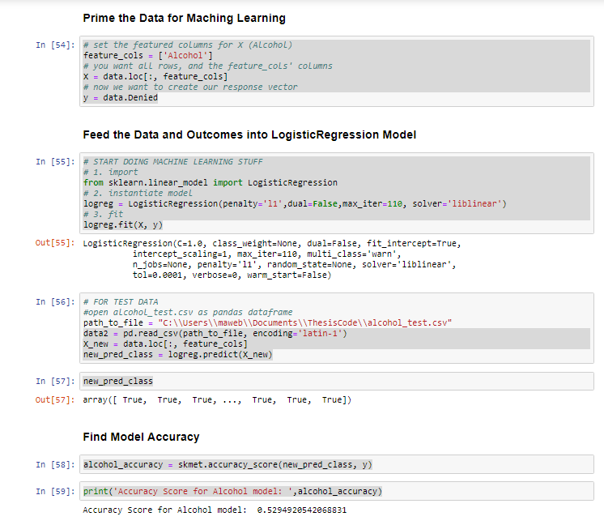
Predicting outcomes
https://github.com/mawebster9/ThesisCode/blob/master/Thesis%20-%20Alcohol.ipynb
Notes:
All notebooks follow the same flow
Prime the data for input (columns in db – true/false vals)
Feed into sci-kit learn model for log reg to build fit
Send in test data to predict the outcome based on training data
Spit out predictions
Calculate accuracy based on model

Slide 9
Use cases and limitations
Accuracy is low due to model/data input
More data needed
Ethics behind machines vs people
Bulky to maintain/use
Notes:
Accuracy was about 50% -> essentially coin toss
Different types of models would be better suited for types of input data (text, time)
More data = better results
Machines making these decisions

Slide 10
Future work
Drugs and alcohol
More data points
Data models/input robustness
Notes:
Drugs and alcohol – use vs abuse, recency, types of drugs
Add most recent years of data – the more the better
Expand on other guidelines – not started because input not in line with log reg input (text instead of T/F)
More graphs and explanations for model outputs and data

Slide 11

https://usatodayhss.com/2018/recruiting-column-10-questions-a-college-coach-might-ask-you

